Slide 1
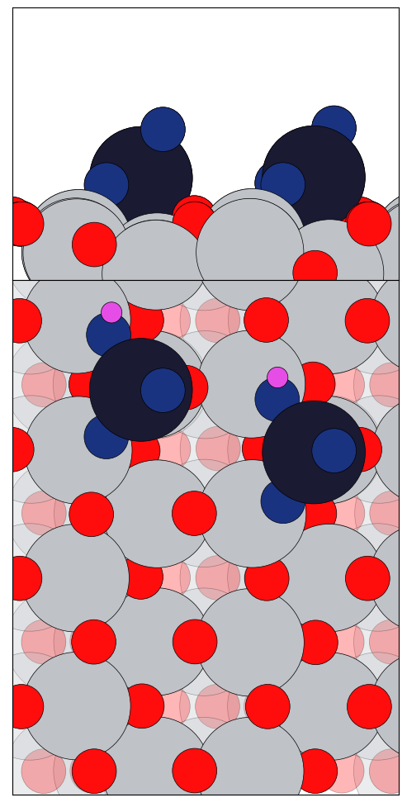
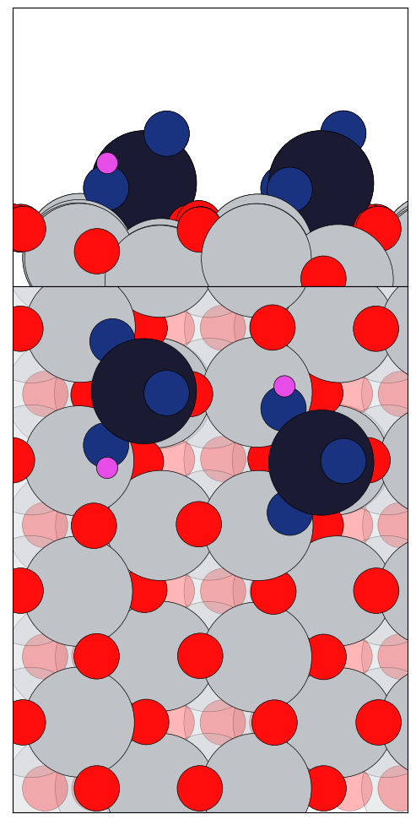
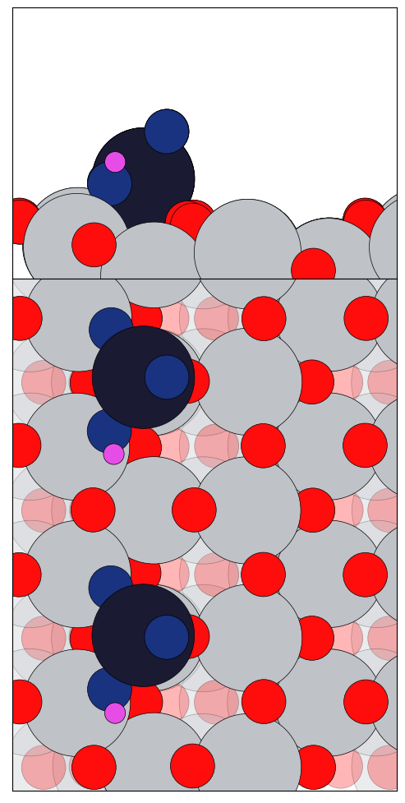
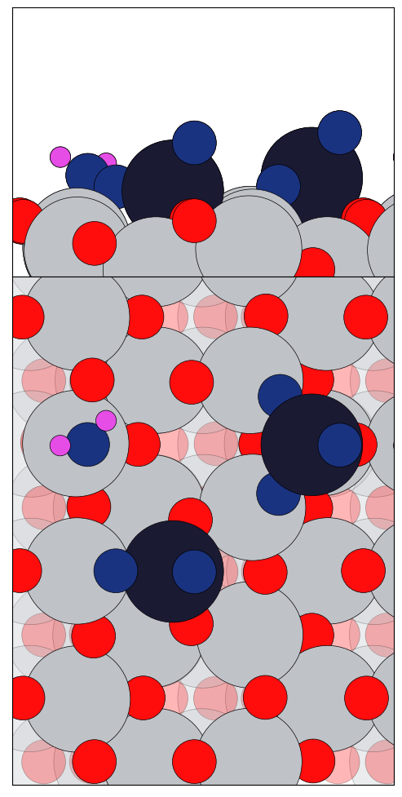
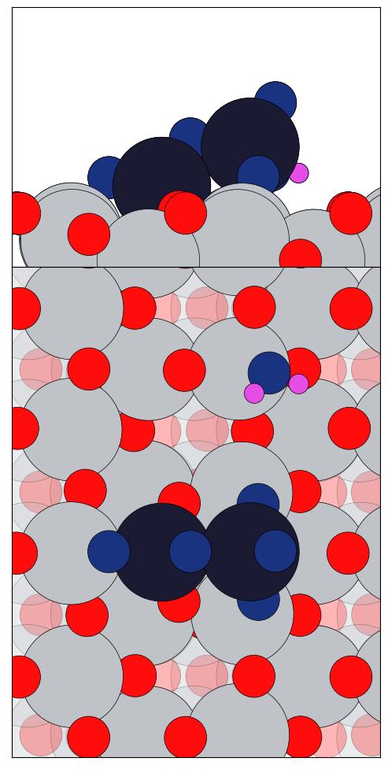
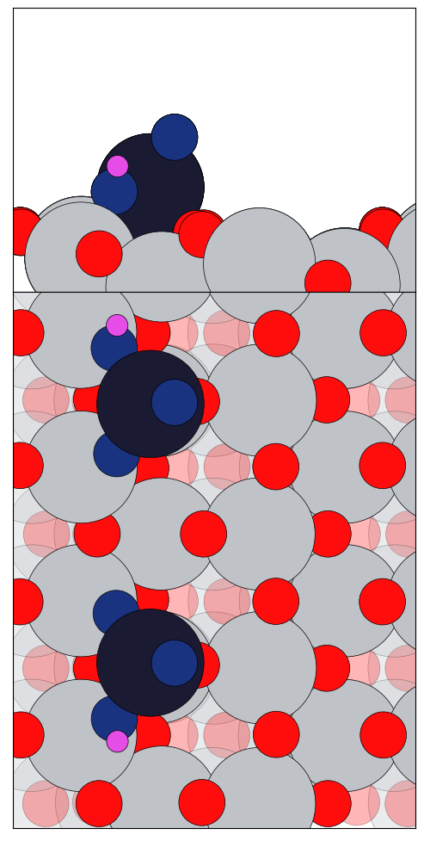
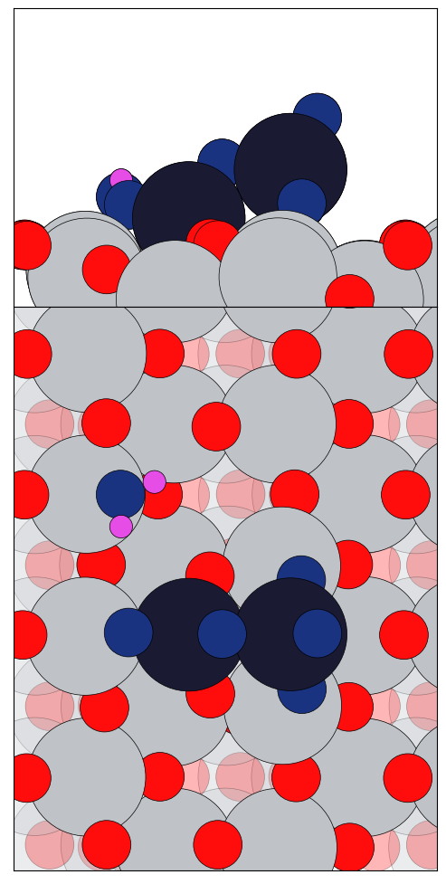
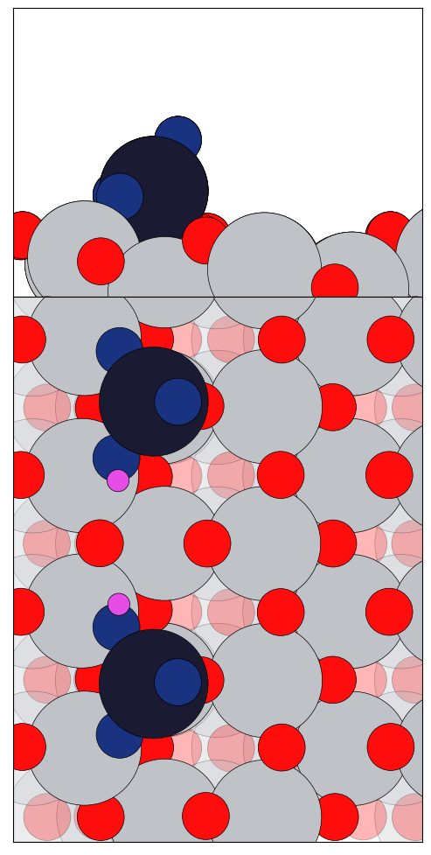
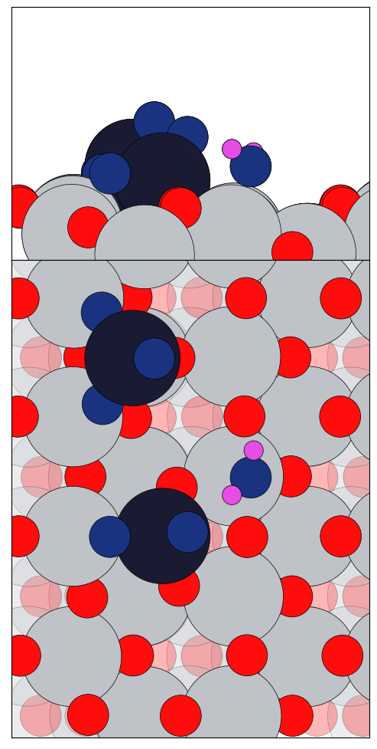
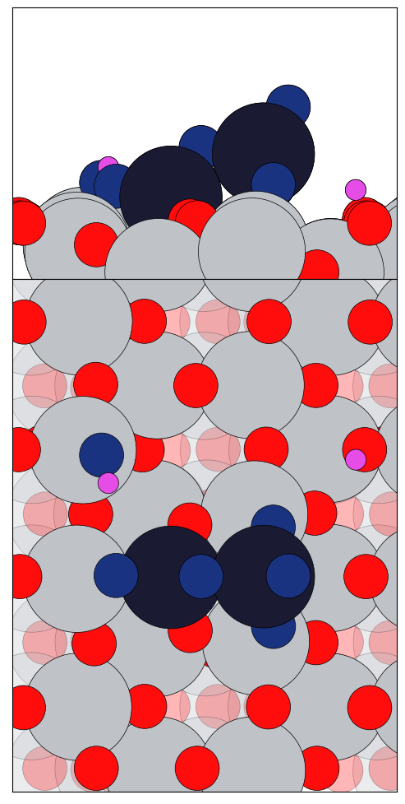
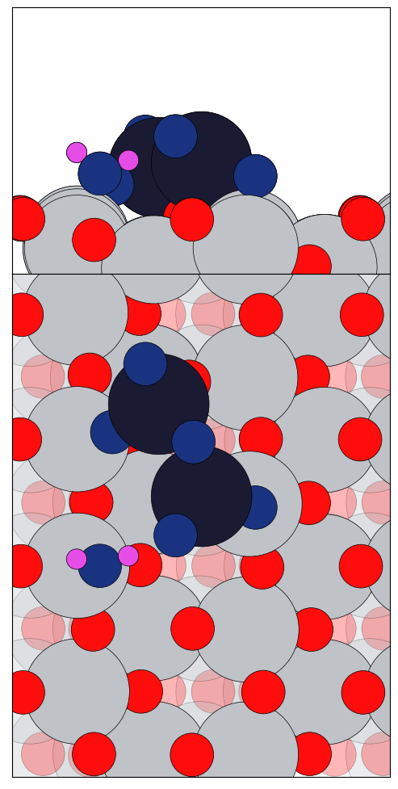
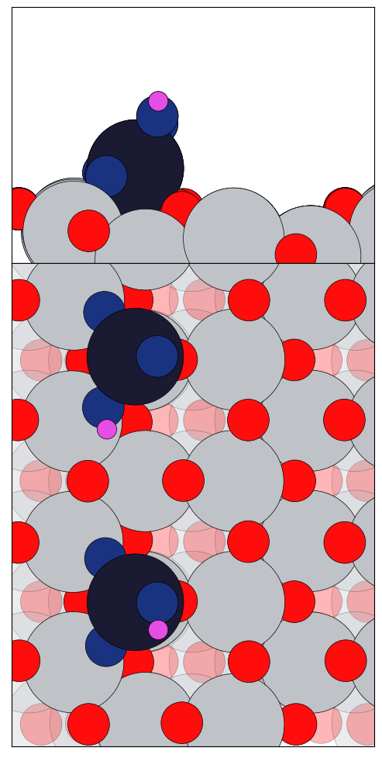
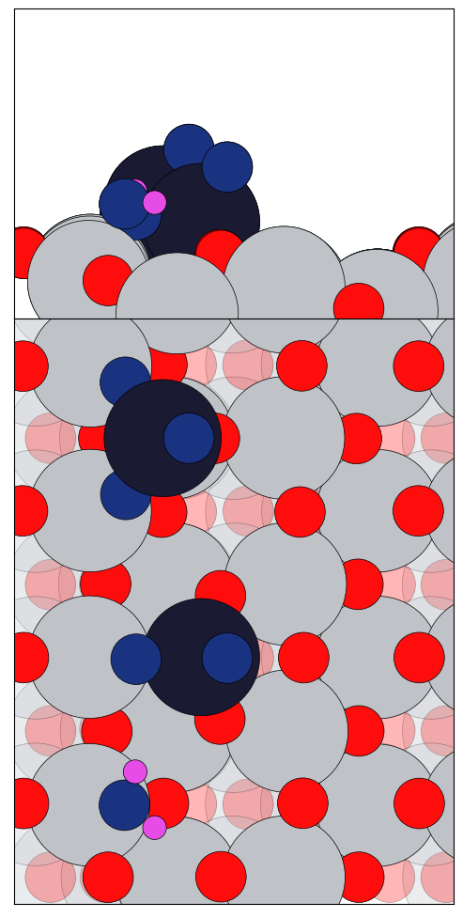
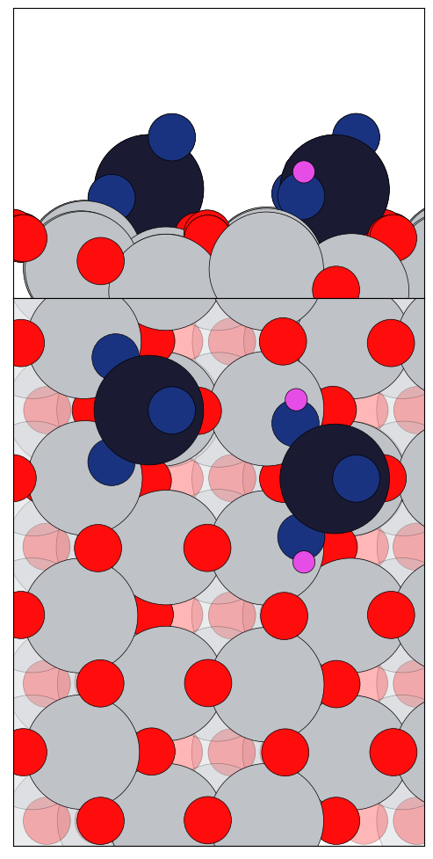
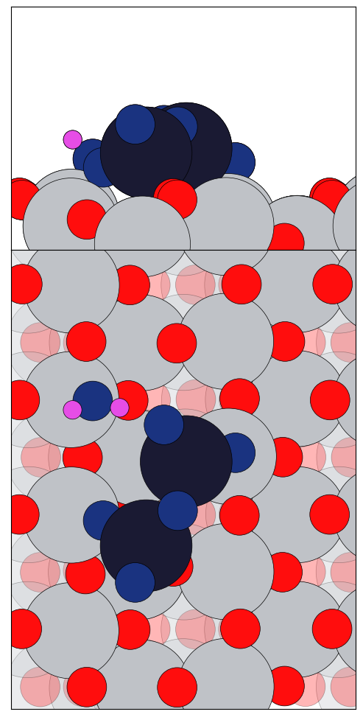
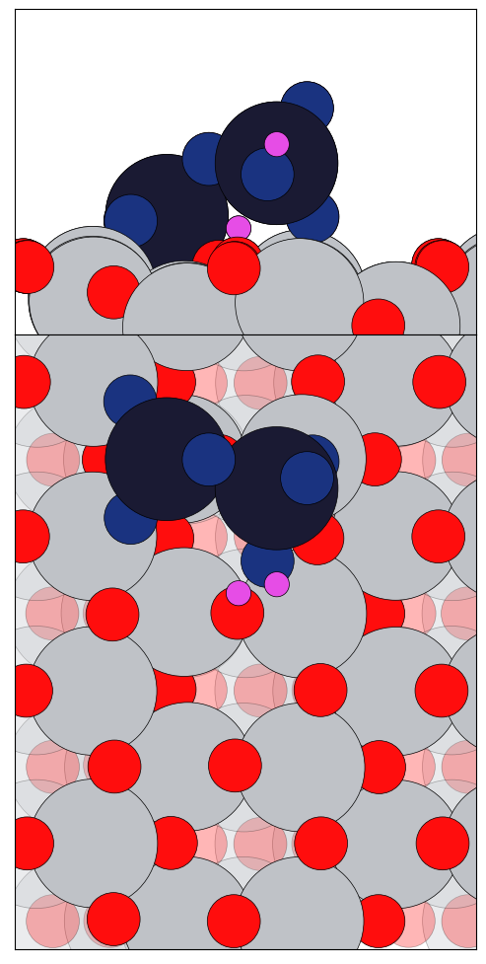
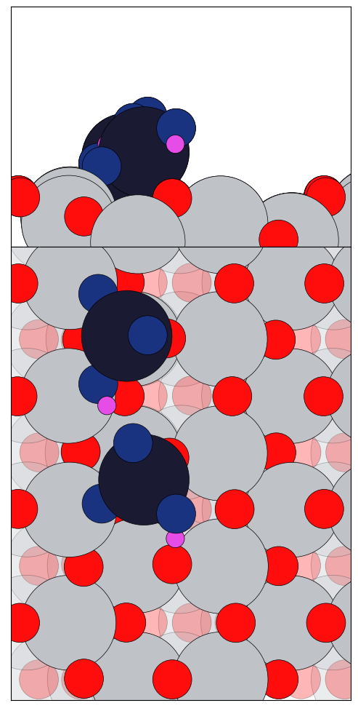
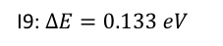
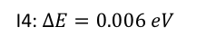
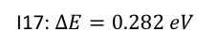
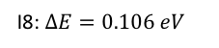
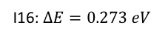
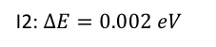
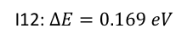
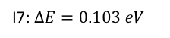
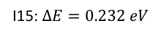
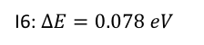
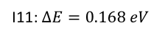
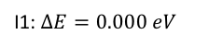
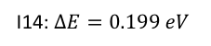
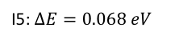
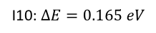
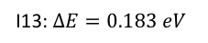
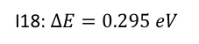
I1: $∆E=0.000 eV$
I2: $∆E=0.002 eV$
I4: $∆E=0.006 eV$
I5: $∆E=0.068 eV$
I6: $∆E=0.078 eV$
I7: $∆E=0.103 eV$
I8: $∆E=0.106 eV$
I9: $∆E=0.133 eV$
I10: $∆E=0.165 eV$
I11: $∆E=0.168 eV$
I12: $∆E=0.169 eV$
I13: $∆E=0.183 eV$
I14: $∆E=0.199 eV$
I15: $∆E=0.232 eV$
I16: $∆E=0.273 eV$
I17: $∆E=0.282 eV$
I18: $∆E=0.295 eV$

Slide 2
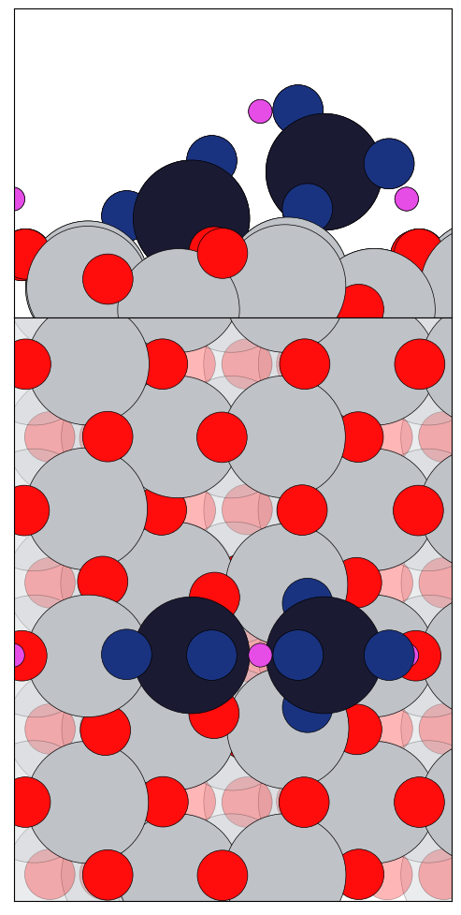
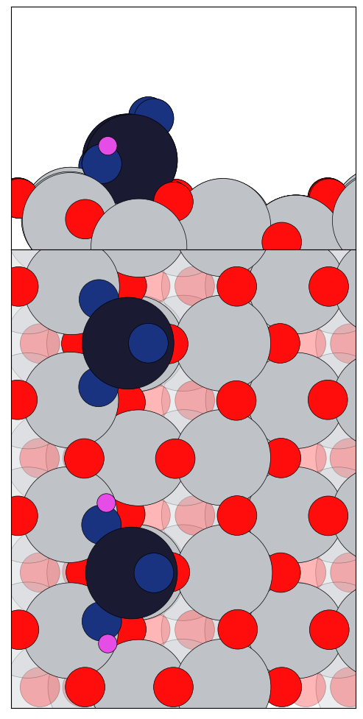

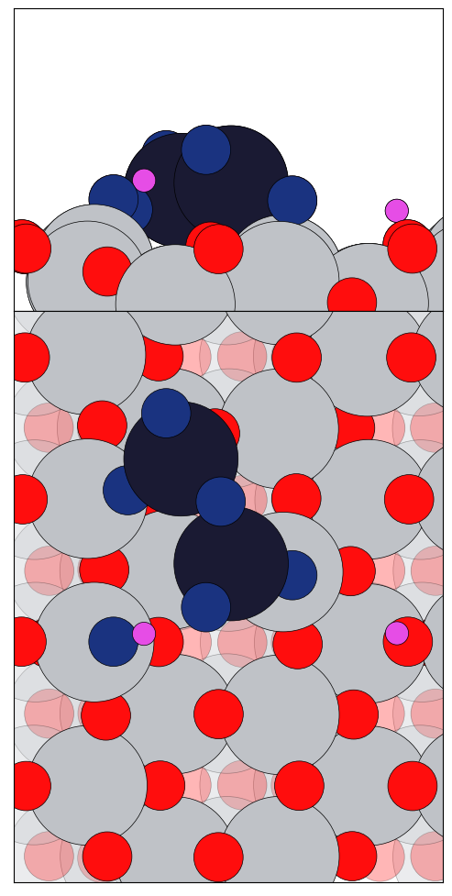
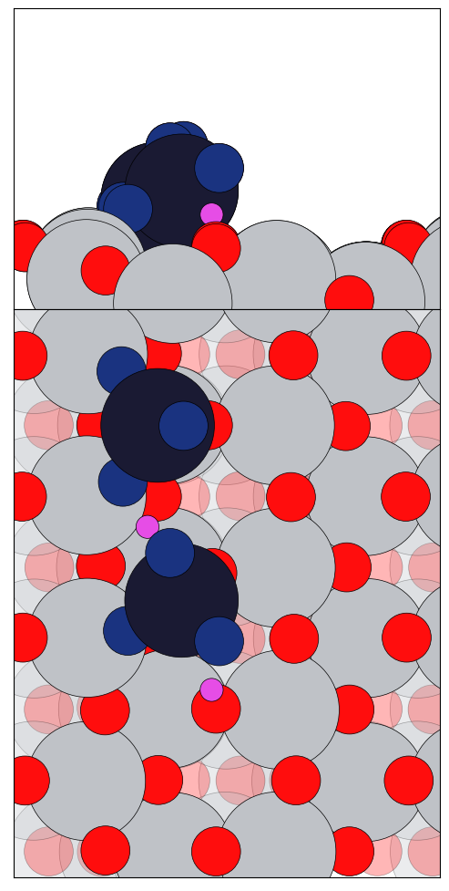
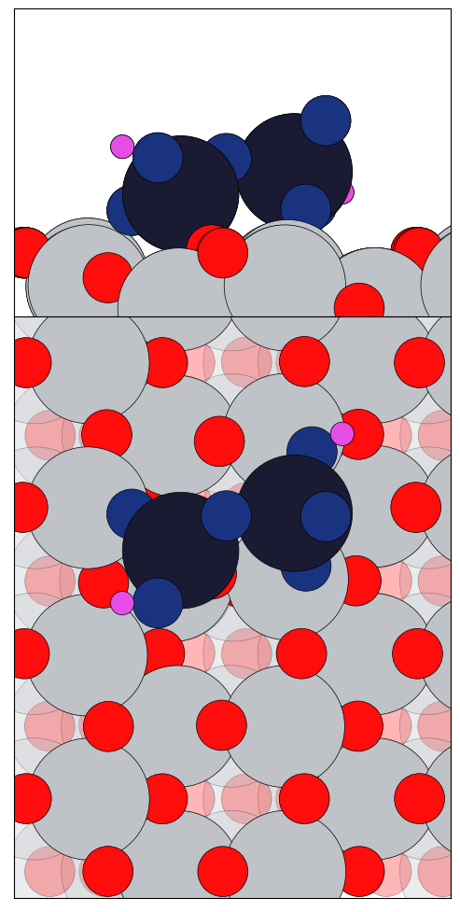
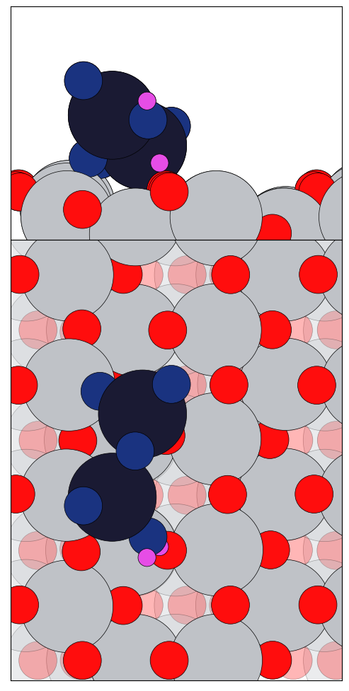
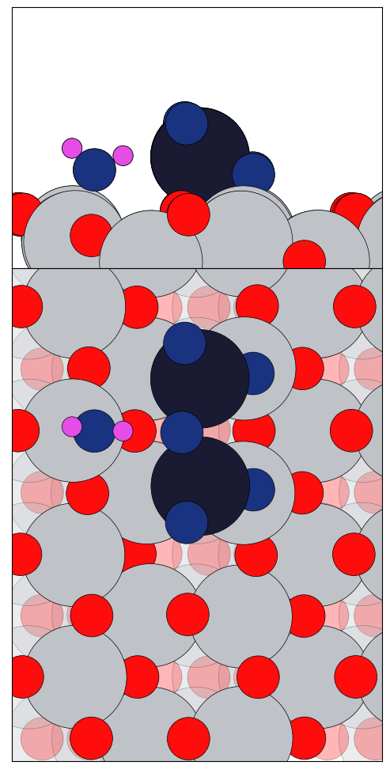
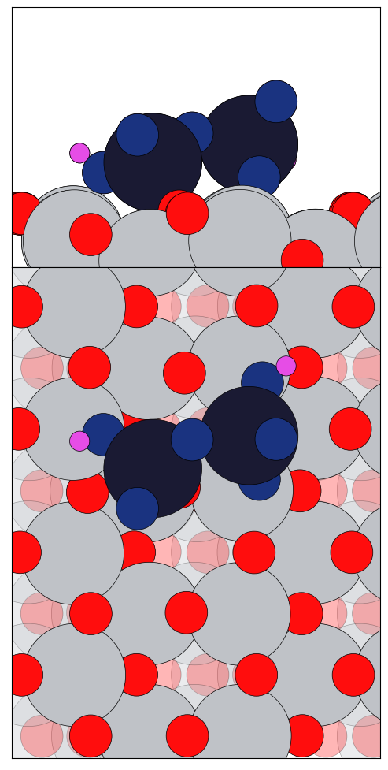
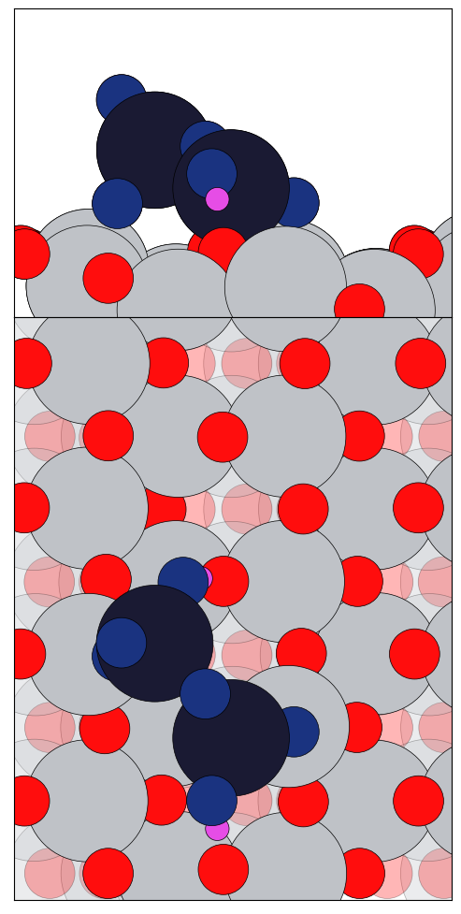
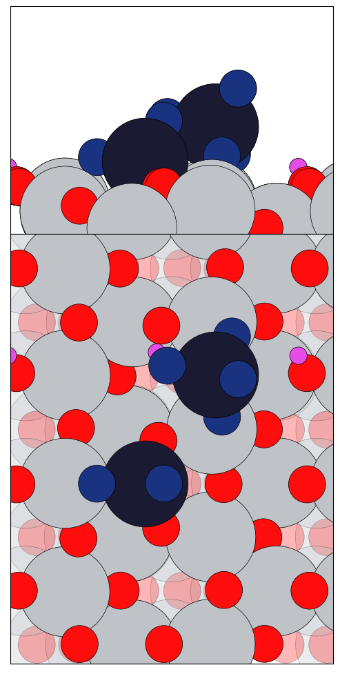
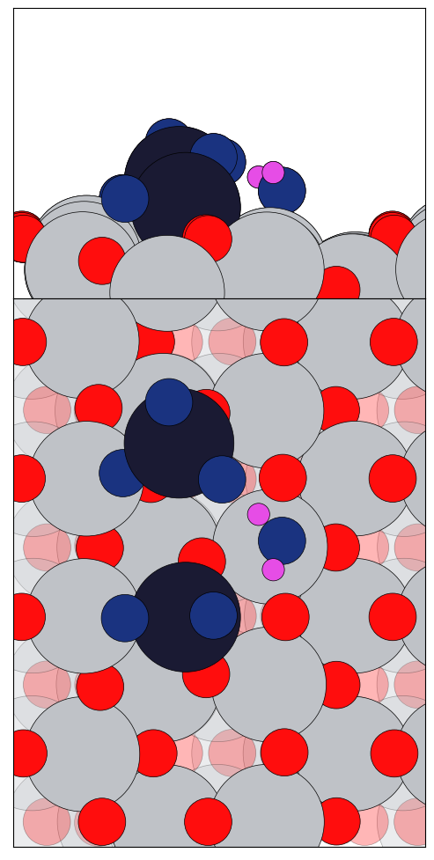
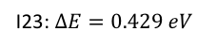
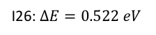
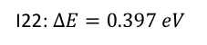
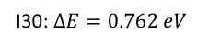
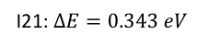







I19: $∆E=0.330 eV$
I20: $∆E=0.341 eV$
I21: $∆E=0.343 eV$
I22: $∆E=0.397 eV$
I23: $∆E=0.429 eV$
I24: $∆E=0.484 eV$
I25: $∆E=0.513 eV$
I26: $∆E=0.522 eV$
I27: $∆E=0.575 eV$
I28: $∆E=0.605 eV$
I29: $∆E=0.629 eV$
I30: $∆E=0.762 eV$

Slide 3
































I1: $∆E=0.000 eV$
I2: $∆E=0.046 eV$
I3: $∆E=0.053 eV$
I4: $∆E=0.120 eV$
I5: $∆E=0.147 eV$
I6: $∆E=0.153 eV$
I7: $∆E=0.154 eV$
I8: $∆E=0.165 eV$
I10: $∆E=0.170 eV$
I11: $∆E=0.196 eV$
I12: $∆E=0.218 eV$
I13: $∆E=0.227 eV$
I14: $∆E=0.232 eV$
I15: $∆E=0.244 eV$
I16: $∆E=0.253 eV$
I17: $∆E=0.260 eV$

Slide 4
































I18: $∆E=0.280 eV$
I19: $∆E=0.283 eV$
I20: $∆E=0.292 eV$
I21: $∆E=0.294 eV$
I22: $∆E=0.317 eV$
I23: $∆E=0.362 eV$
I24: $∆E=0.382 eV$
I25: $∆E=0.412 eV$
I26: $∆E=0.425 eV$
I27: $∆E=0.439 eV$
I28: $∆E=0.443 eV$
I29: $∆E=0.447 eV$
I30: $∆E=0.448 eV$
I31: $∆E=0.474 eV$
I32: $∆E=0.581 eV$
I33: $∆E=0.631 eV$

Slide 5














I34: $∆E=0.643 eV$
I35: $∆E=0.736 eV$
I36: $∆E=0.790 eV$
I37: $∆E=0.795 eV$
I38: $∆E=0.805 eV$
I39: $∆E=0.836 eV$
I40: $∆E=1.22 eV$

Slide 6







I1: $∆E=0.000 eV$
I2: $∆E=0.046 eV$
I4: $∆E=0.120 eV$
I5: $∆E=0.147 eV$
I11: $∆E=0.196 eV$
I17: $∆E=0.260 eV$
I18: $∆E=0.280 eV$
I23: $∆E=0.362 eV$
I25: $∆E=0.412 eV$

Slide 7











I3: $∆E=0.053 eV$
I6: $∆E=0.153 eV$
I7: $∆E=0.154 eV$
I8: $∆E=0.165 eV$
I10: $∆E=0.170 eV$
I14: $∆E=0.232 eV$
I21: $∆E=0.294 eV$
I26: $∆E=0.425 eV$
I33: $∆E=0.631 eV$
I35: $∆E=0.736 eV$
I39: $∆E=0.836 eV$

Slide 8















I12: $∆E=0.218 eV$
I13: $∆E=0.227 eV$
I15: $∆E=0.244 eV$
I16: $∆E=0.253 eV$
I19: $∆E=0.283 eV$
I20: $∆E=0.292 eV$
I22: $∆E=0.317 eV$
I24: $∆E=0.382 eV$
I27: $∆E=0.439 eV$
I28: $∆E=0.443 eV$
I29: $∆E=0.447 eV$
I30: $∆E=0.448 eV$
I31: $∆E=0.474 eV$
I36: $∆E=0.790 eV$
I38: $∆E=0.805 eV$

